Slide 1
KHATRA ADIBASI MAHAVIDYALAYA
P.O- Khatra, Dist.-Bankura, West Bengal, Pin-722140
Name of the Teacher- Swarnava Chakraborty
Class- Semester - I
Subject- Physical Education
Course Tittle : History and Foundation of Physical Education
Topic- Better understanding of the meaning of Physical Education with other sub - disciplines
Session: 2023-24

Slide 2
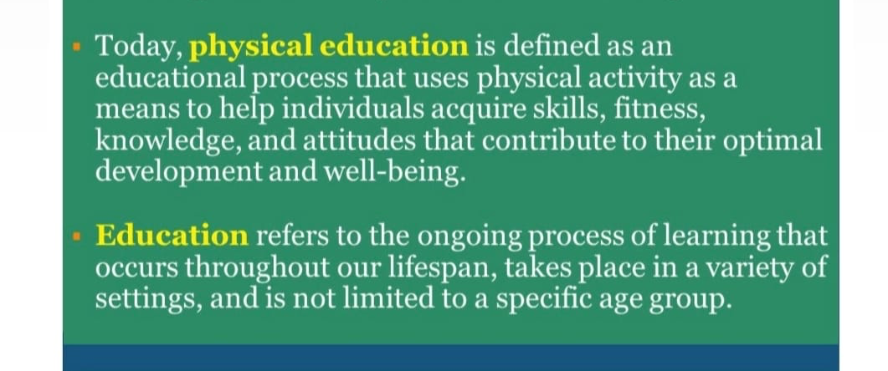

Slide 3
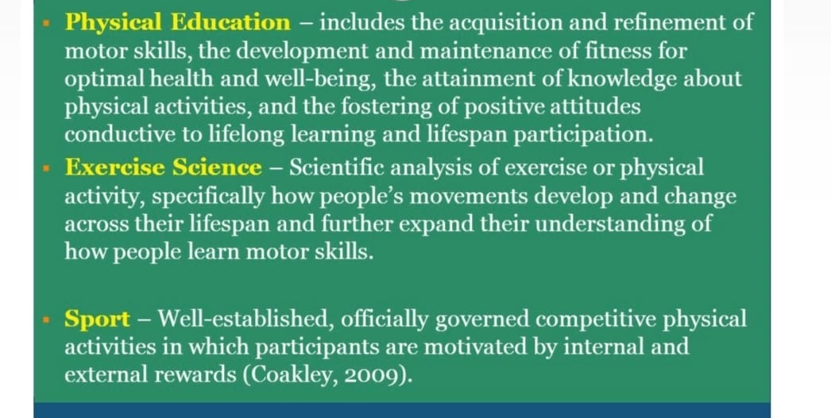

Slide 4


Slide 5
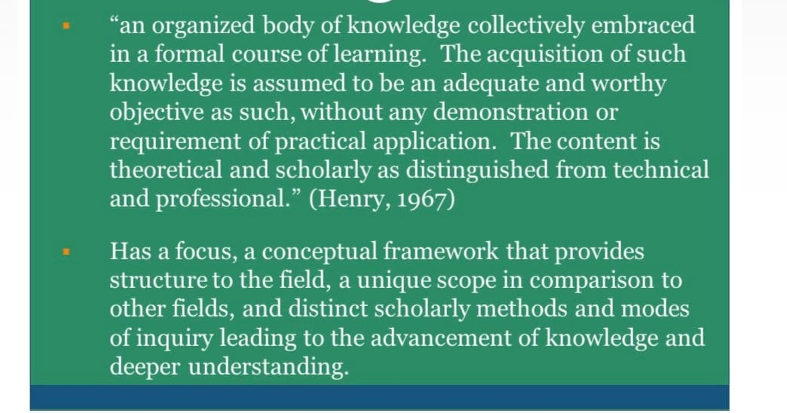

Slide 6
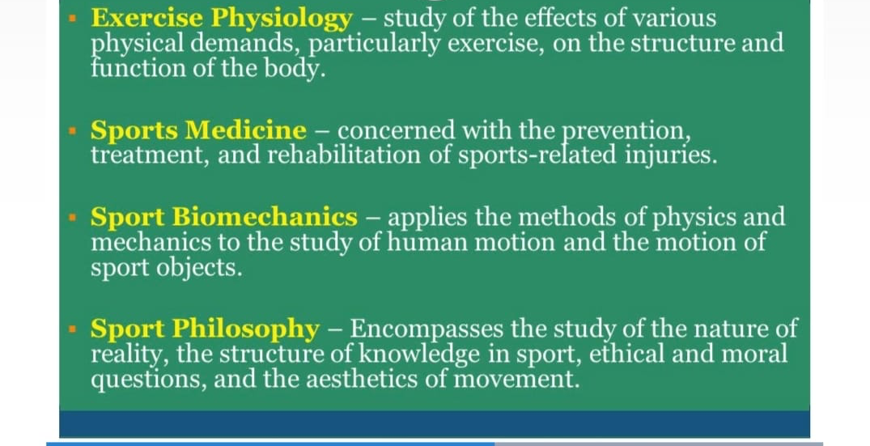

Slide 7
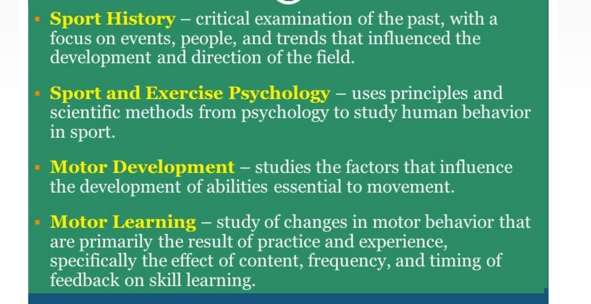

Slide 8
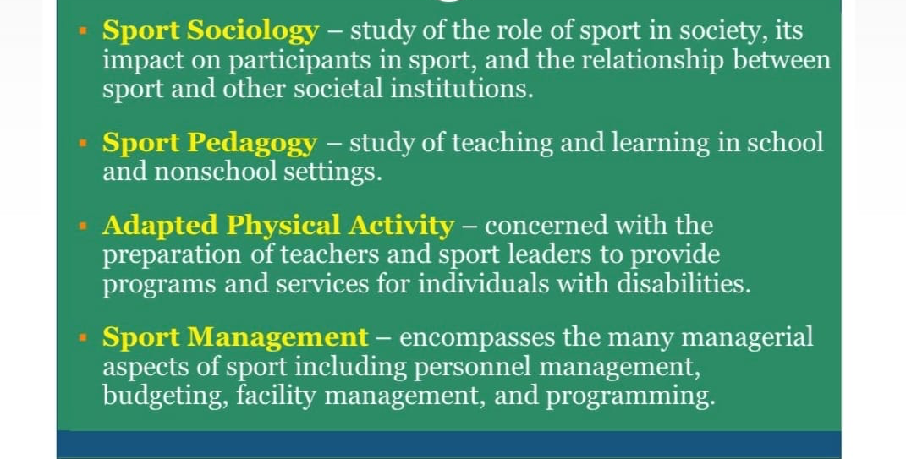

Slide 9
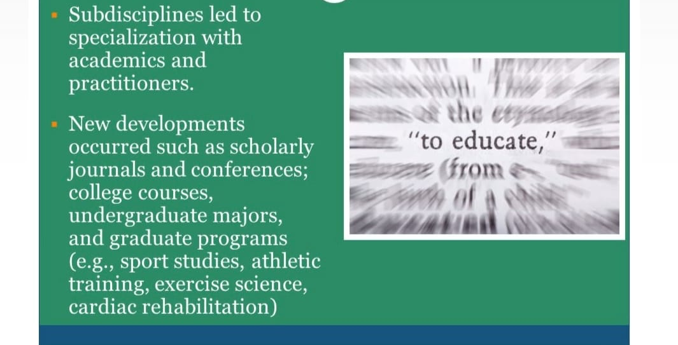

Slide 10
Reference
Book name -
ESSENTIALS OF PHYSICAL EDUCATION
by AJMER SINGH & JAGDISH

